Slide 1

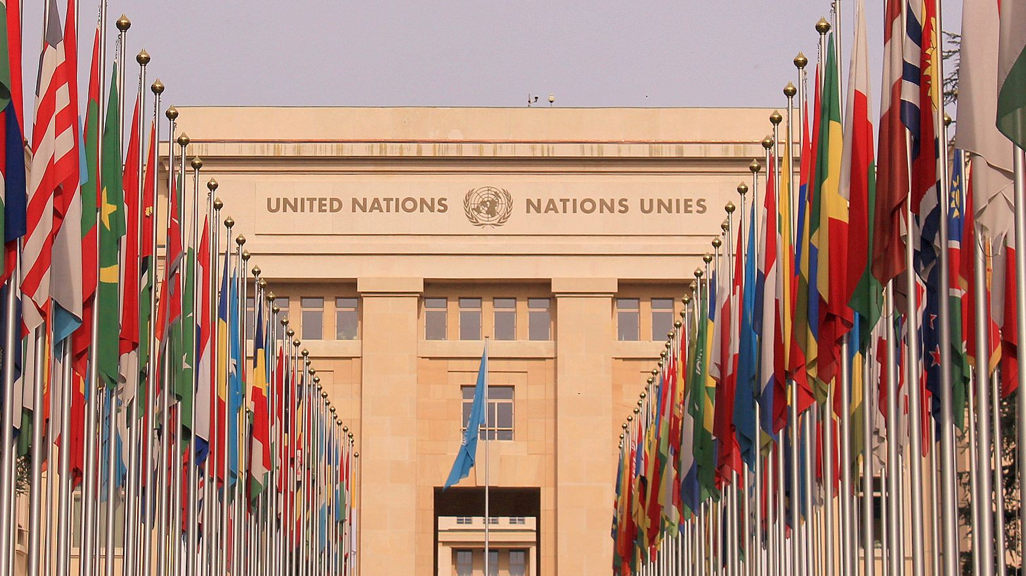
Behavioural Research and Experiment Design Project
Pranoy J, 2019115004
Vivek R, 2019112020
This Photo by Unknown author is licensed under CC BY-NC-ND.

Slide 2
Does the nationalistic rhetoric employed by Conservative leaders different from Liberal leaders in contemporary global politics affect listeners differently?
A survey study from the public side

Slide 3
There is a qualitative difference between the way nationalistic rhetoric is used in Conservative politics as opposed to Liberalist Politics
Hypothesis

Slide 4

Literature Review

Slide 5
Huntington, S. P. (1999). Robust nationalism. The National Interest, (58), 31-40.
Stanley, J. (2020). How Fascism Works: The Politics of Us and Them. Random House Publishing Group
Lægaard, S. (2007). Liberal nationalism and the nationalisation of liberal values. Nations and Nationalism, 13(1), 37-55.
Gellner, E. (1991). Nationalism and politics in Eastern Europe. New Left Review, 189(5), 127-34.
Persson, Mikael & Solevid, Maria. (2013). Measuring Political Participation--Testing Social Desirability Bias in a Web-Survey Experiment. International Journal of Public Opinion Research. 26. 98-112. 10.1093/ijpor/edt002.
Bullock, J. G., & Lenz, G. (2019). Partisan bias in surveys. Annual Review of Political Science, 22, 325-342.
Kasunic, M. (2005). Designing an effective survey. Carnegie-Mellon Univ Pittsburgh PA Software Engineering Inst.
The Literature

Slide 6
Conclusions from the Literature Review
Both Liberalist and Conservatist politics employ Nationalism
Nationalism is an effective rhetoric tool
Academia suggests that nationalism as a rhetoric technique is associated more to Conservatism than Liberalism
The political bias of each participant is a key extraneous variable that needs to be considered during data collection
Designing an effective survey is hard

Slide 7

The Research Instrument

Slide 8
The Basics
Online survey (Google forms)
Participants will act as raters
3-phase survey process
Phase 1: assess biases
Phase 2, 3: data collection
Risks involved: As an assessment of each participant's political bias is done, it may lead to slight apprehensions due to a possible conflict with self-opinion and opinions expressed in Phase 1 of the questionnaire.
INFORMED AT THE BEGINNING OF THE SURVEY

Slide 9
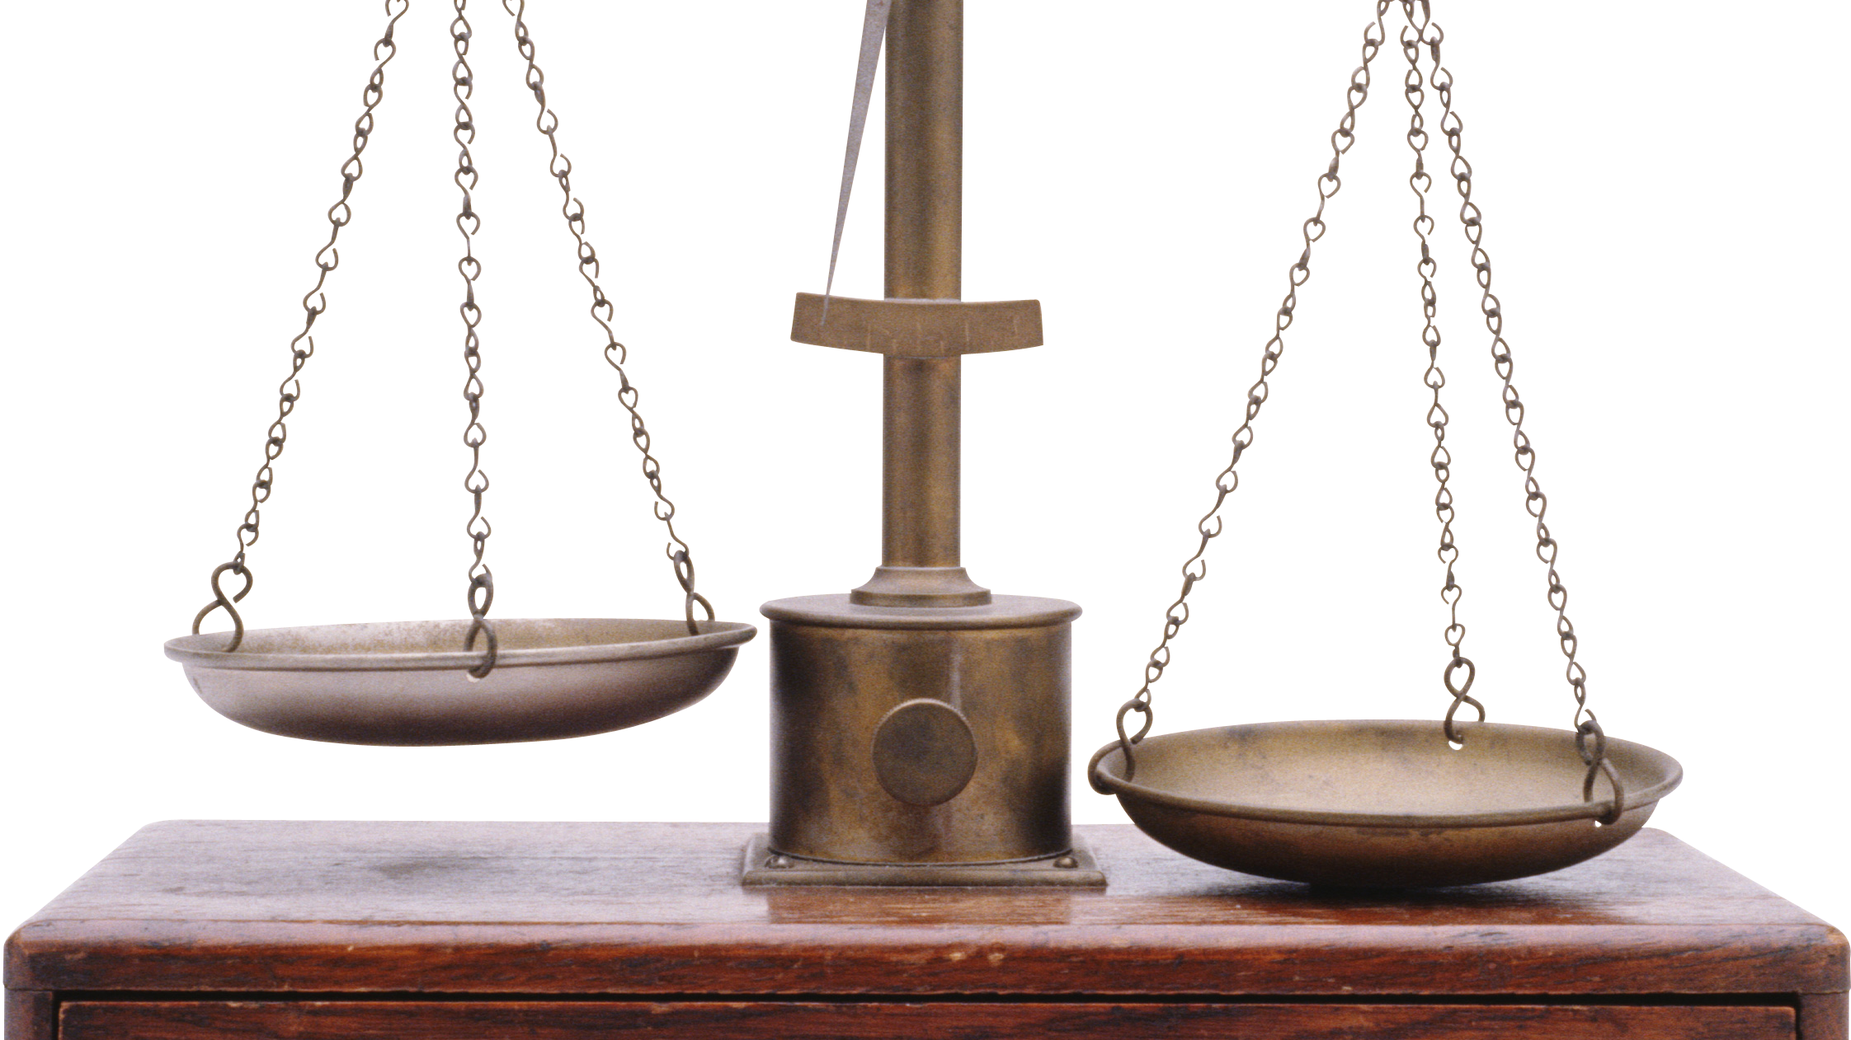
Phase 1
Meant to assess the political bias of each participant
A spectrum between Conservatism and Liberalism
Apolitical, Other options also considered
Direct question
Follow up question to ascertain bias
Opinions on major partisan events
Objective descriptions of transpired events provided
This Photo by Unknown author is licensed under CC BY-NC.

Slide 10

Phase 2
The first set of stimuli is provided here
The Stimuli
Quotes from political leaders from past centuries
Ratings the perceived nationalistic intent of the quote
Additional information to check for characteristic traits
Set a precedent
Why quotes, specifically?

Slide 11
Phase 3
The second set of stimuli is provided here.
Similar set of questions
Additional question:
Associating phase 3 with phase 2
What's different between the quotes?
Contemporary leaders
Explicitly chosen not to represent the Indian nation

Slide 12

The Quotes

Slide 13
Background information
Conditions for choosing a quote:
Purely rhetoric
Evidently referring to nationalistic sentiments
Ascertaining the nature of a stimulus:
Alliance of the speaker

Slide 14
Examples:
God favor our work, shape our will in the right way, bless our vision and bless us with the trust of our people. We have no desire to fight for ourselves; only for [the nation].
Hitler
Conservative
I am speaking to each of you today. To all of you who who make up together the people of [this nation]. We have a duty towards our country. We have inherited a great history, we have inherited a great humanist message.
Emmanuel Macron
Liberal

Slide 15
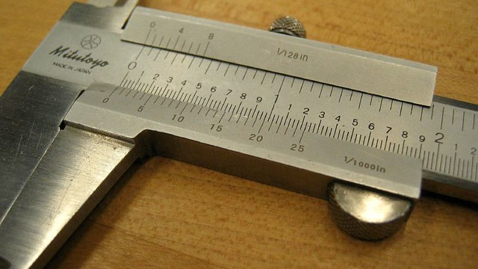
Reliabilty of the Research Instrument
This Photo by Unknown author is licensed under CC BY-NC-ND.

Slide 16
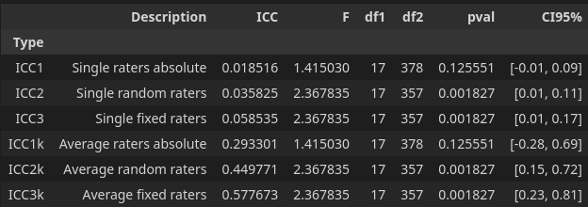
Internal Consistency
Internal Consistency
Cronbach's alpha: 0.9237818932460822
Inter-rater Consistency
Fleiss' kappa: 0.10841501902449105
Intra-rater Consistency

Slide 17
Outlier Detection
The Inter-Quartile Range:
Outliers for Quote 3: [10]
Outliers for Quote 4: [10 15]
Outliers for Quote 5: [10]
Outliers for Quote 6: [ 2 3 4 10]
Outliers for Quote 7: [ 9 10 11]
Outliers for Quote 8: [ 7 10]
Outliers for Quote 9: [ 4 7 10]
Outliers for Quote 10: [ 7 10]
Outliers for Quote 11: [ 2 3 10 13]
Outliers for Quote 12: [10]
Outliers for Quote 14: [10]
Outliers for Quote 15: [ 3 4 6 12 15 20]
Outliers for Quote 16: [ 9 10]
Outliers for Quote 17: [10]
Z-scores
Outliers for quote 6: [10]
Outliers for quote 7: [10]
Outliers for quote 11: [10]
Outliers for quote 14: [10]

Slide 18

Results

Slide 19
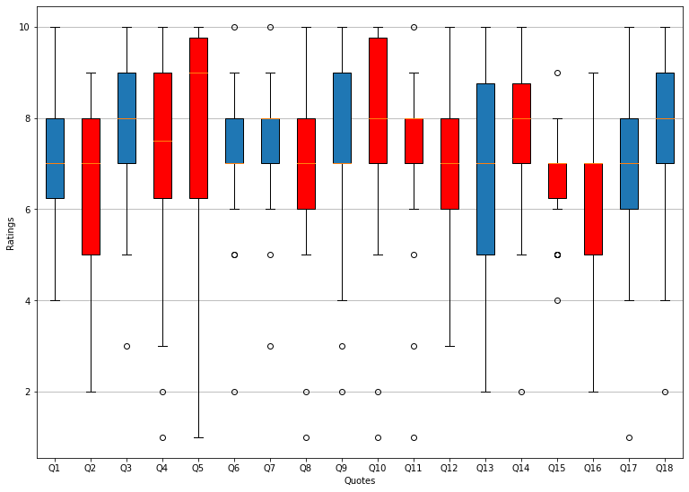
Nationalism score for each quote

Slide 20
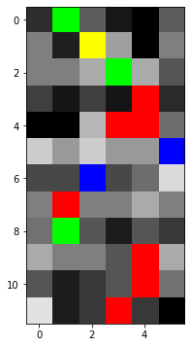
Correlating Phase 2 with Phase 3
Yellow: Liberal as Conservative
Green: Conservative as Liberal

Slide 21

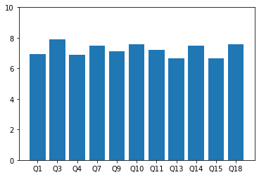
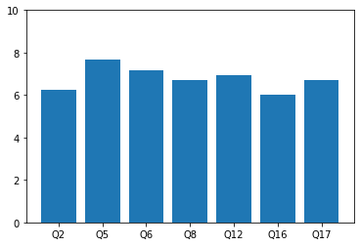
Summarizing the Scores
Conservative
Liberal
Difference in Medians : 0.5

Slide 22
Final Conclusions
There is a variation showing Conservative rhetoric to be more perceivably nationalistic than Liberalist rhetoric.
The observations and analyses show results that mirror premises and conclusions of the literature reviewed.
The political biases assessed were never used as the sample group was found to be homogeneous.

Slide 23
Thank You

